Slide 1
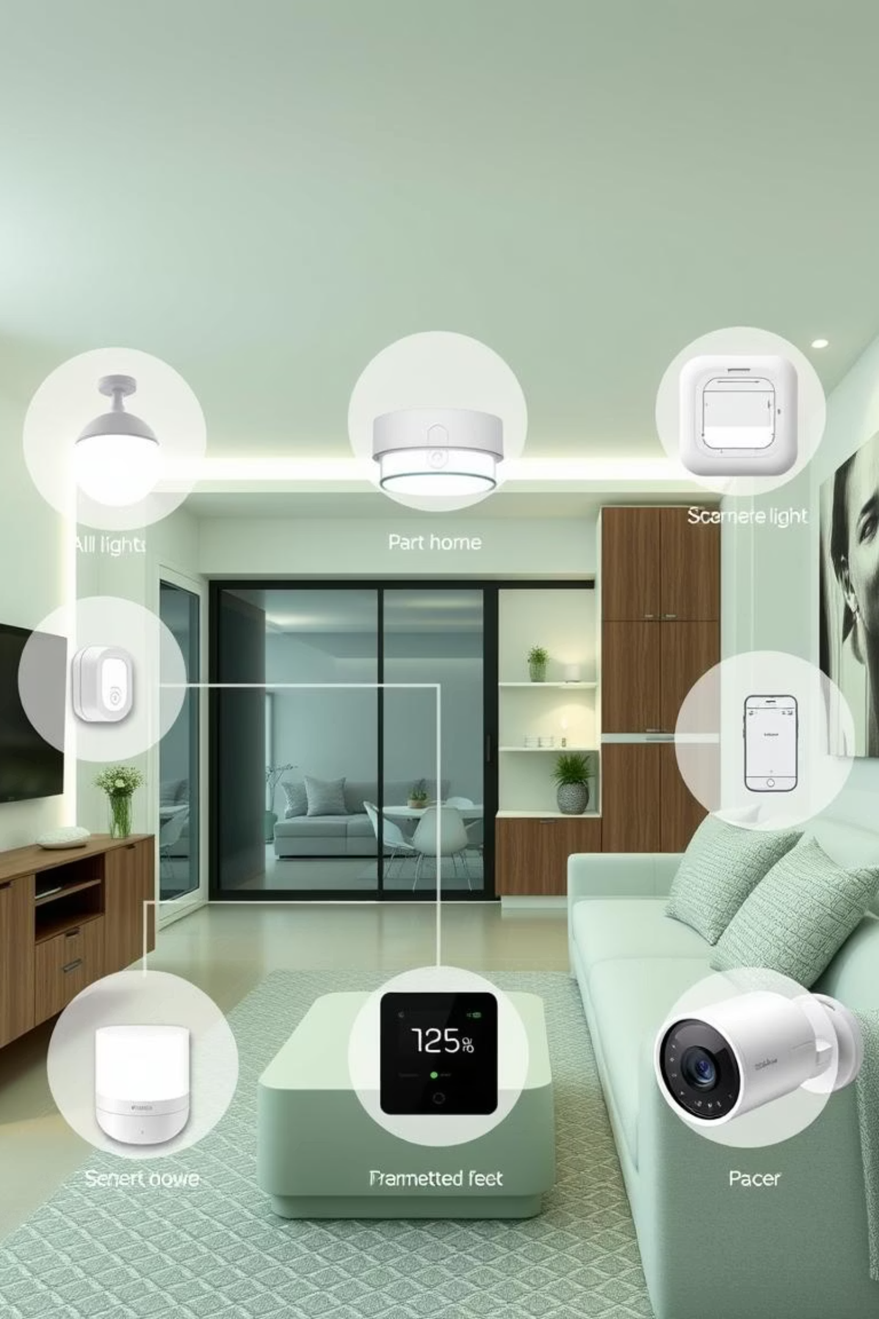
Smart Home Simulation System
An IoT-Powered Automation Solution
Presented by: Abdul Jalil Rohi
Examiners : Prof Davide Ancona Prof Giorgio Delzanno
Subject: IoT
Computer Science Faculty, Software Engineering Department, University of Genova,
Date: 31st-July-2025

Slide 2




Project Objectives
This project demonstrates a comprehensive smart home simulation, integrating IoT concepts for real-time monitoring, automation, and network communication using an ESP32 microcontroller.
Develop a comprehensive smart home simulation using ESP32.
Implement IoT concepts: real-time monitoring, automation, and network communication.
Demonstrate modular architecture for scalability and ease of maintenance.
Deliver a Node-RED dashboard for visualization and control.

Slide 3
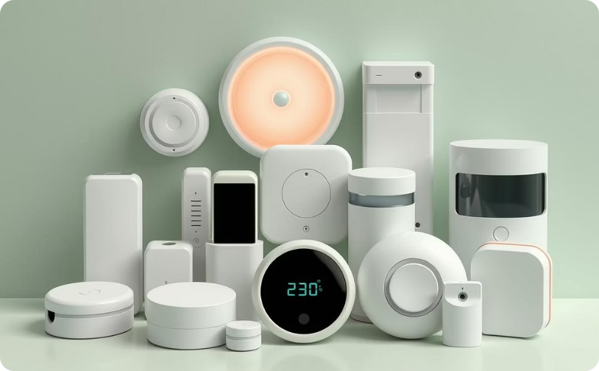
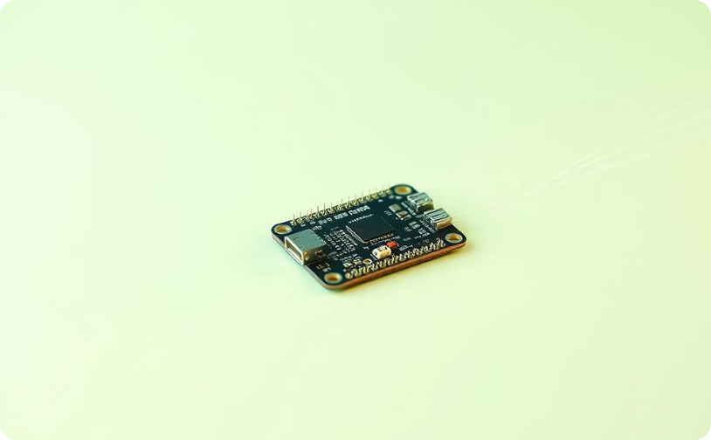
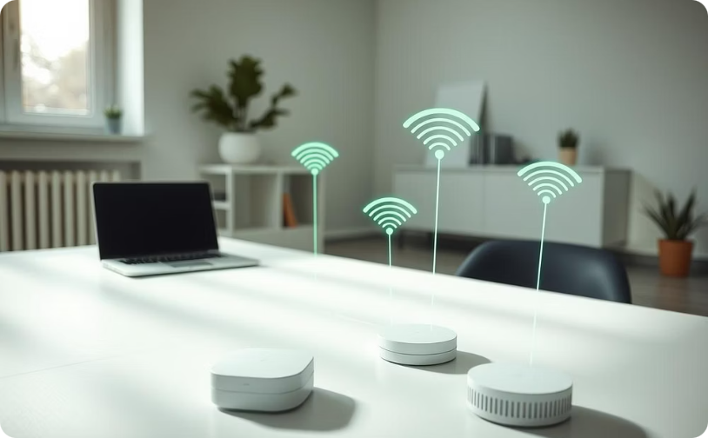
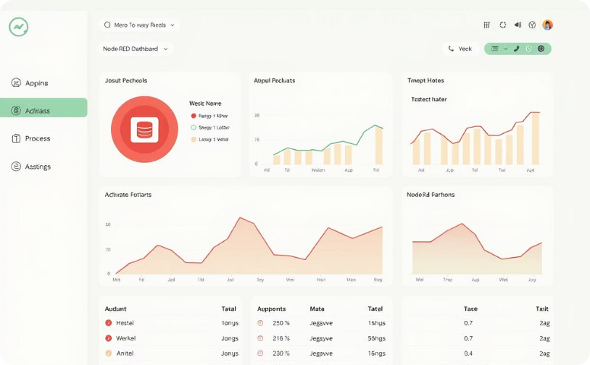
System Architecture
The Smart Home Simulation System is designed with a robust, modular architecture to ensure seamless data flow and efficient processing from sensor to dashboard.
Environmental Sensors
ESP32 Microcontroller
Wireless Communication
Node-RED Dashboard & Database
Collecting real-time data on temperature, humidity, light, and motion from various smart home devices.
The central processing unit at the edge, responsible for data acquisition, initial processing, and local control.
Secure data transmission over Wi-Fi using MQTT protocol to ensure reliable and efficient communication with the server.
Node-RED handles automation logic and data visualization, while a database stores historical sensor data.
This layered approach ensures scalability, maintainability, and responsiveness across all components of the smart home ecosystem.

Slide 4

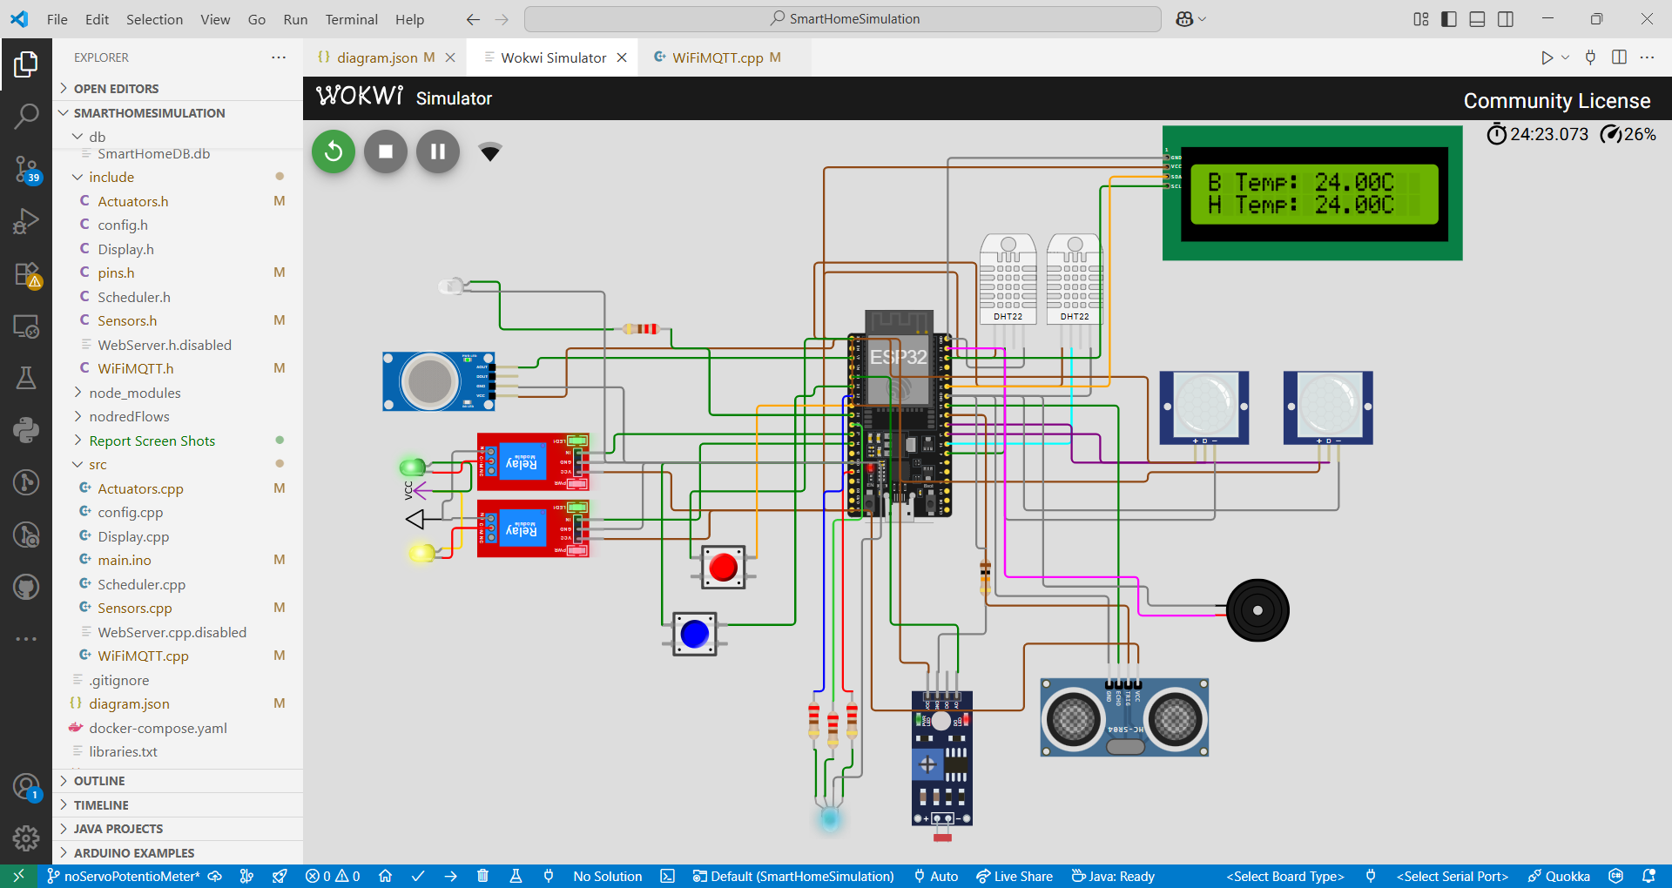


Slide 5
Core Functionalities
Climate Control
DHT22
Relay1 (AC)
AC auto-on >20°C
Gas Safety
MQ-2
Relay2+Buzzer
Exhaust on >3000 ppm
Smart Lighting
PIR+LDR
RGB LED
Motion+Ambient adaptive
Door Security
Ultrasonic
N/A
Open/Closed Status
Toilet Lighting
PIR
LED
Automatic activation
Each functionality is designed to enhance comfort, security, or energy efficiency within the simulated smart home environment.

Slide 6
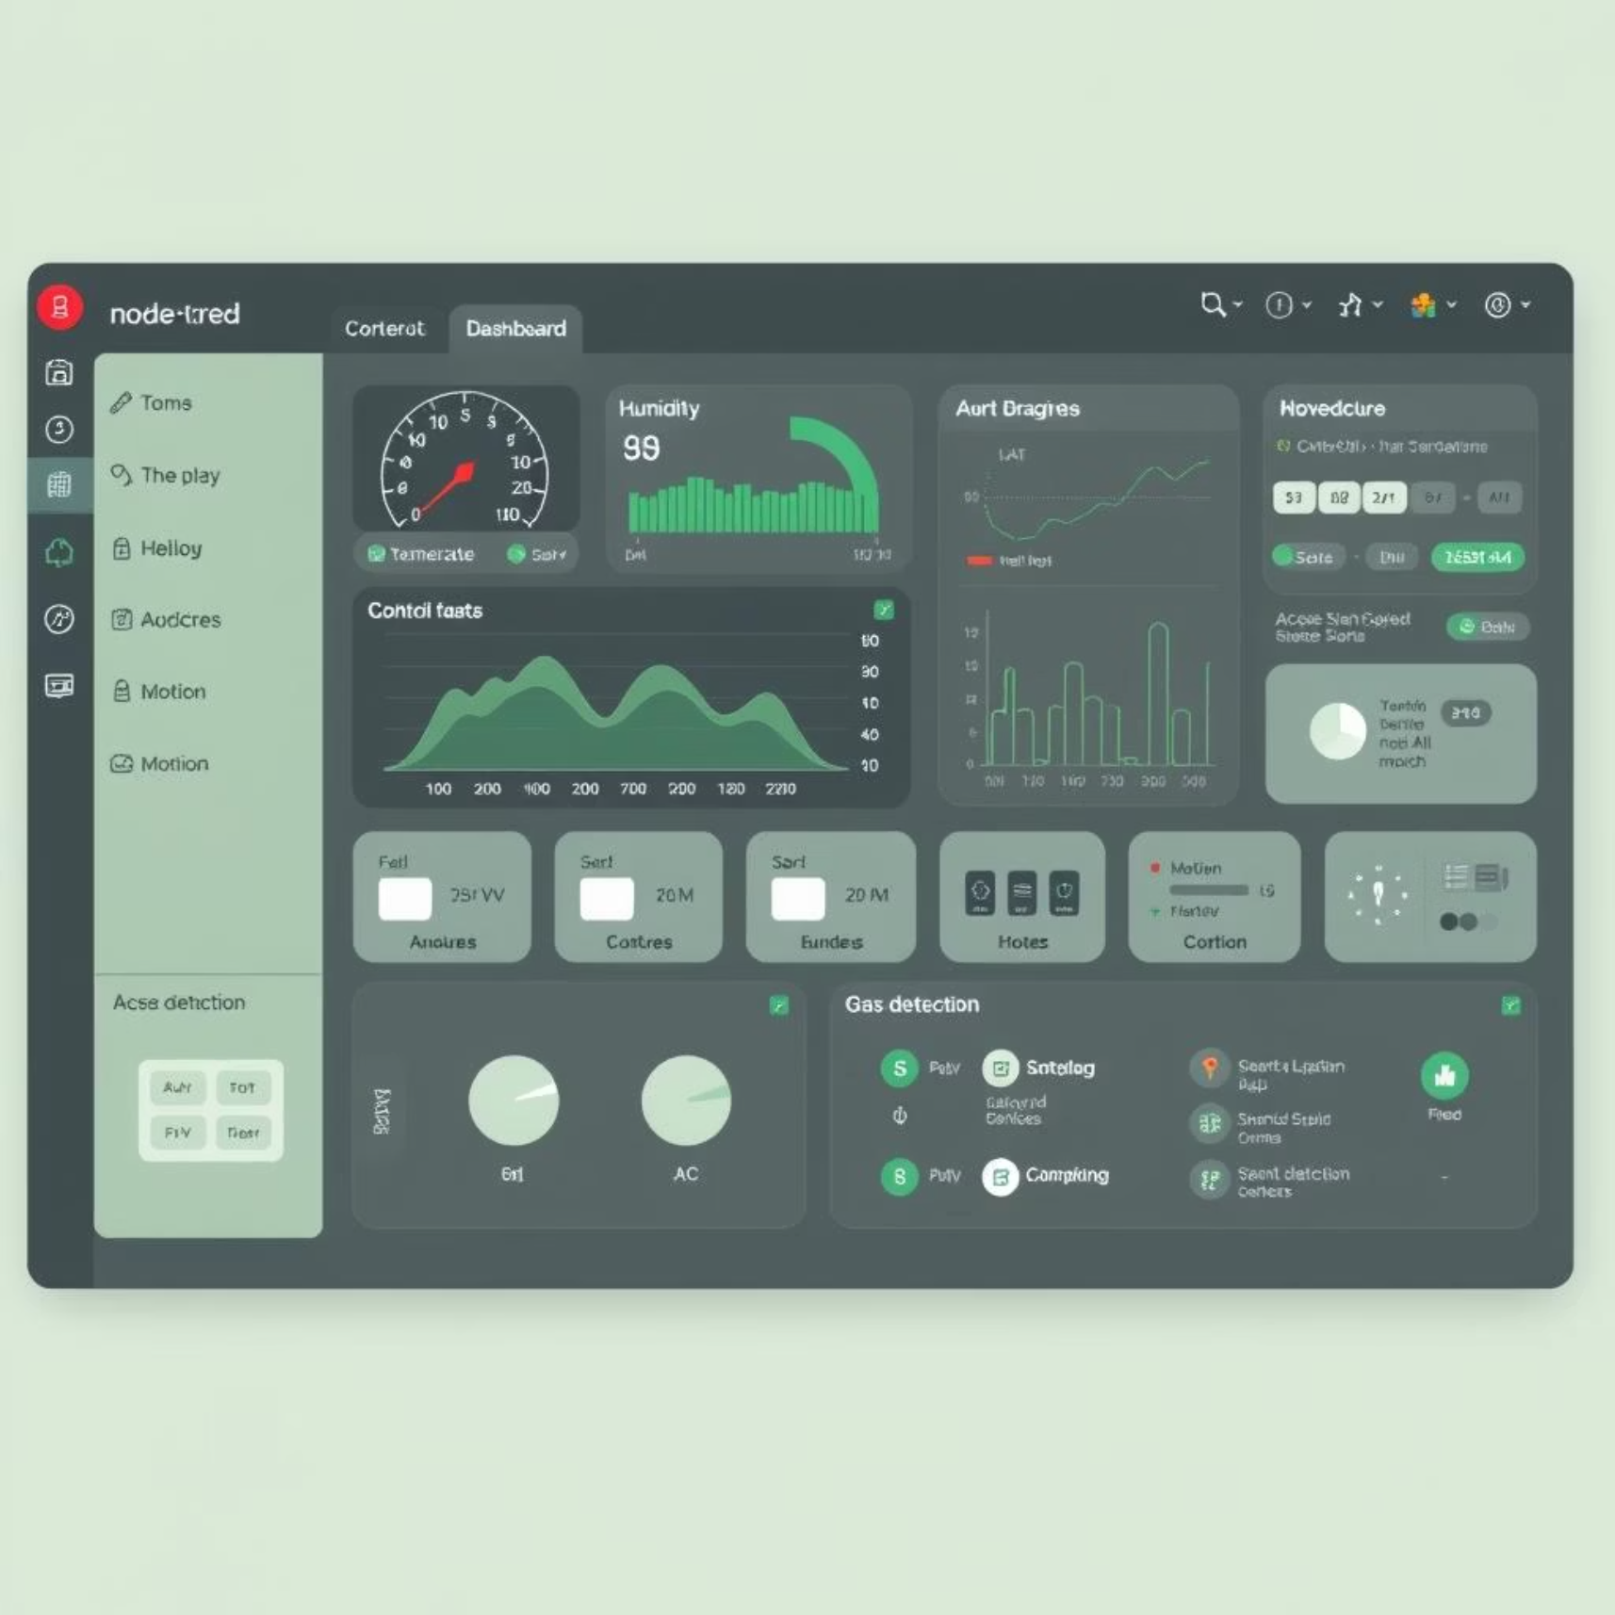
Node-RED Dashboard
The Node-RED dashboard provides a comprehensive user interface for monitoring and controlling the smart home system, offering real-time data visualization and actionable insights.
System Overview: Uptime, WiFi signal, memory, emergency controls.
Environmental Monitoring: Temp/humidity gauges, gas/light indicators, real-time charts.
Security & Motion: Motion LEDs, door status, distance gauge, motion timeline, security toggle.
Automation Control: AC switch/setpoint, RGB picker, fan toggle, toilet light switch.
Analytics & Reports: Temperature trends, motion heatmap, gas history, energy report, event log, device status table.

Slide 7
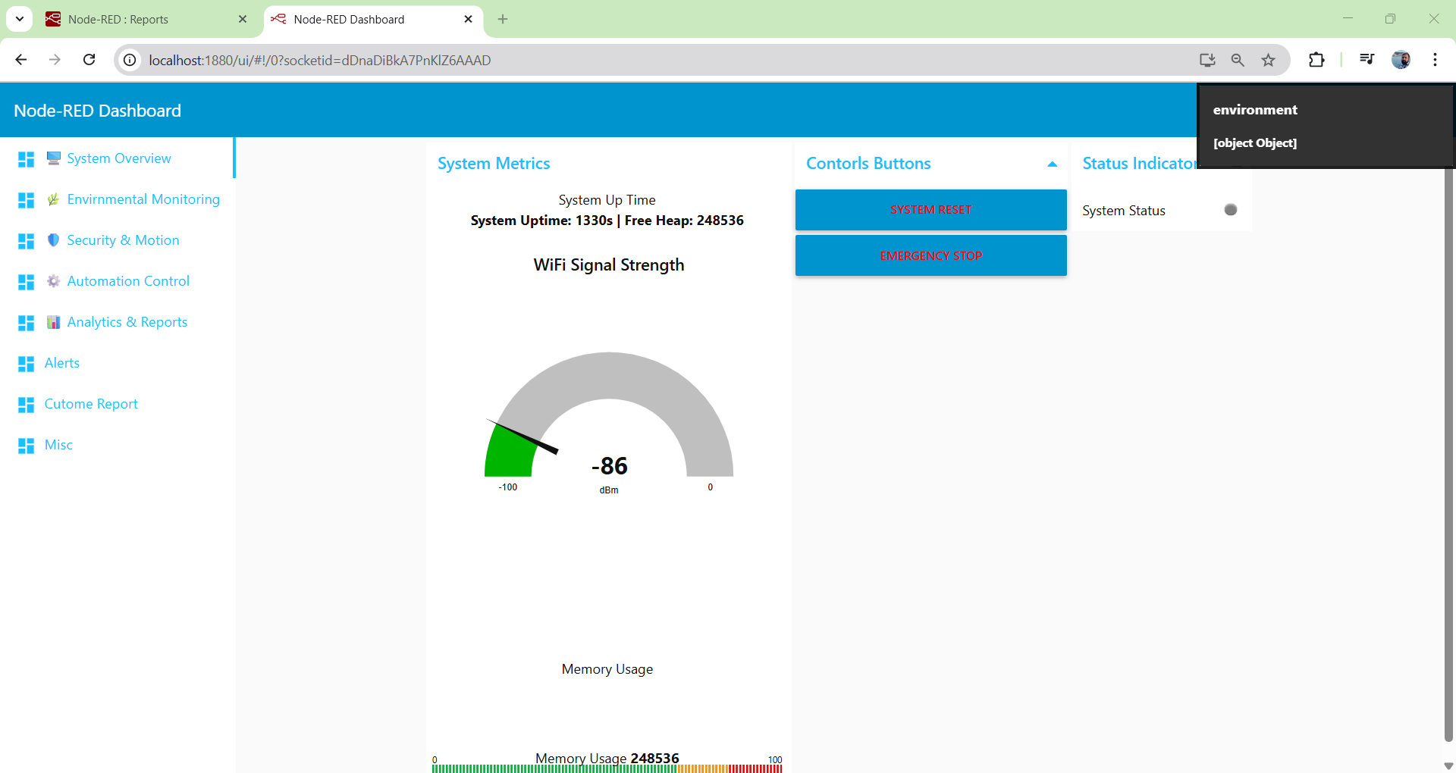
System Overview

Slide 8
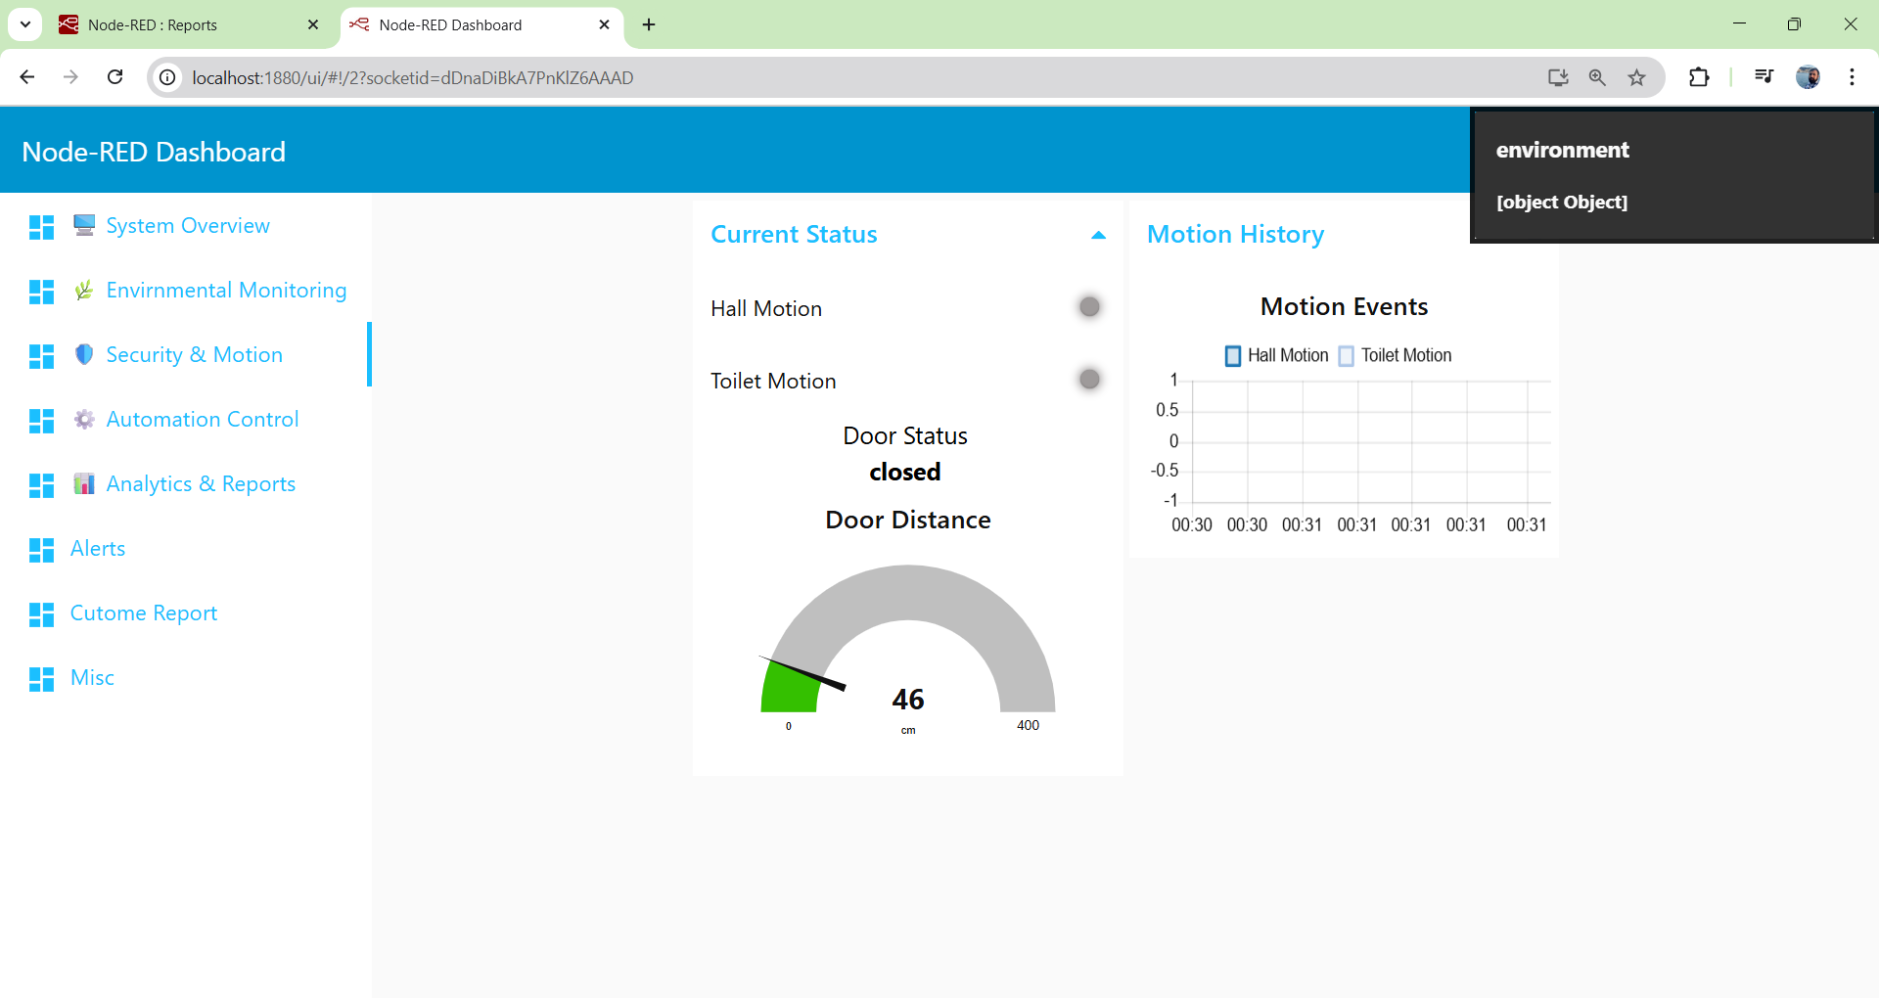

Security & motion

Slide 9
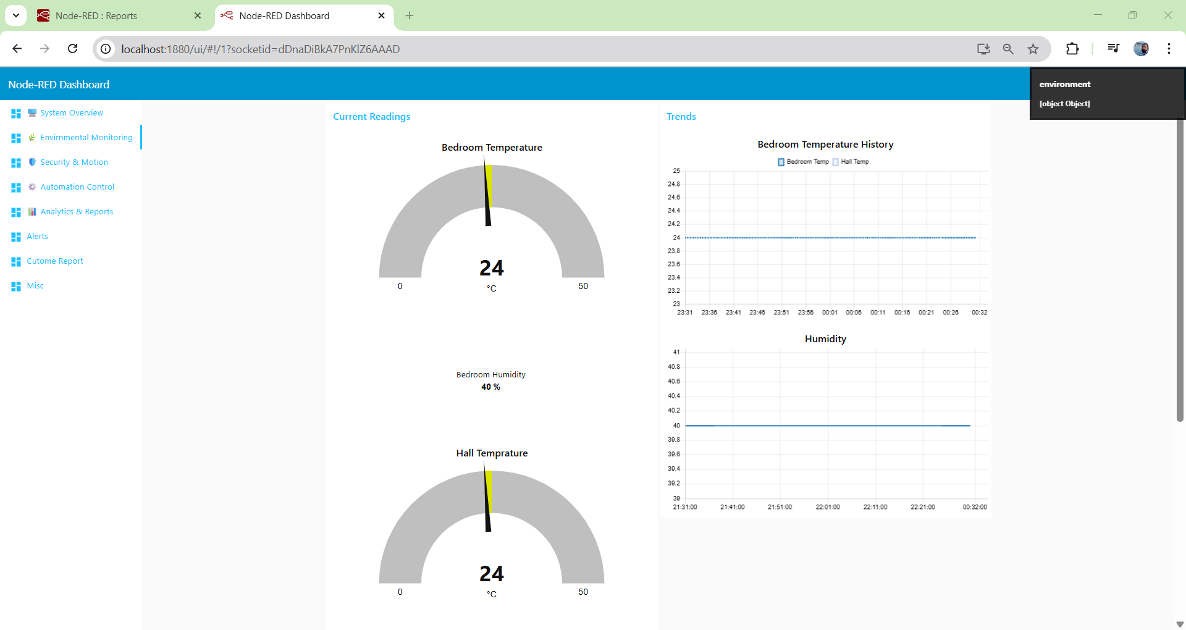
Environmental Monitoring

Slide 10
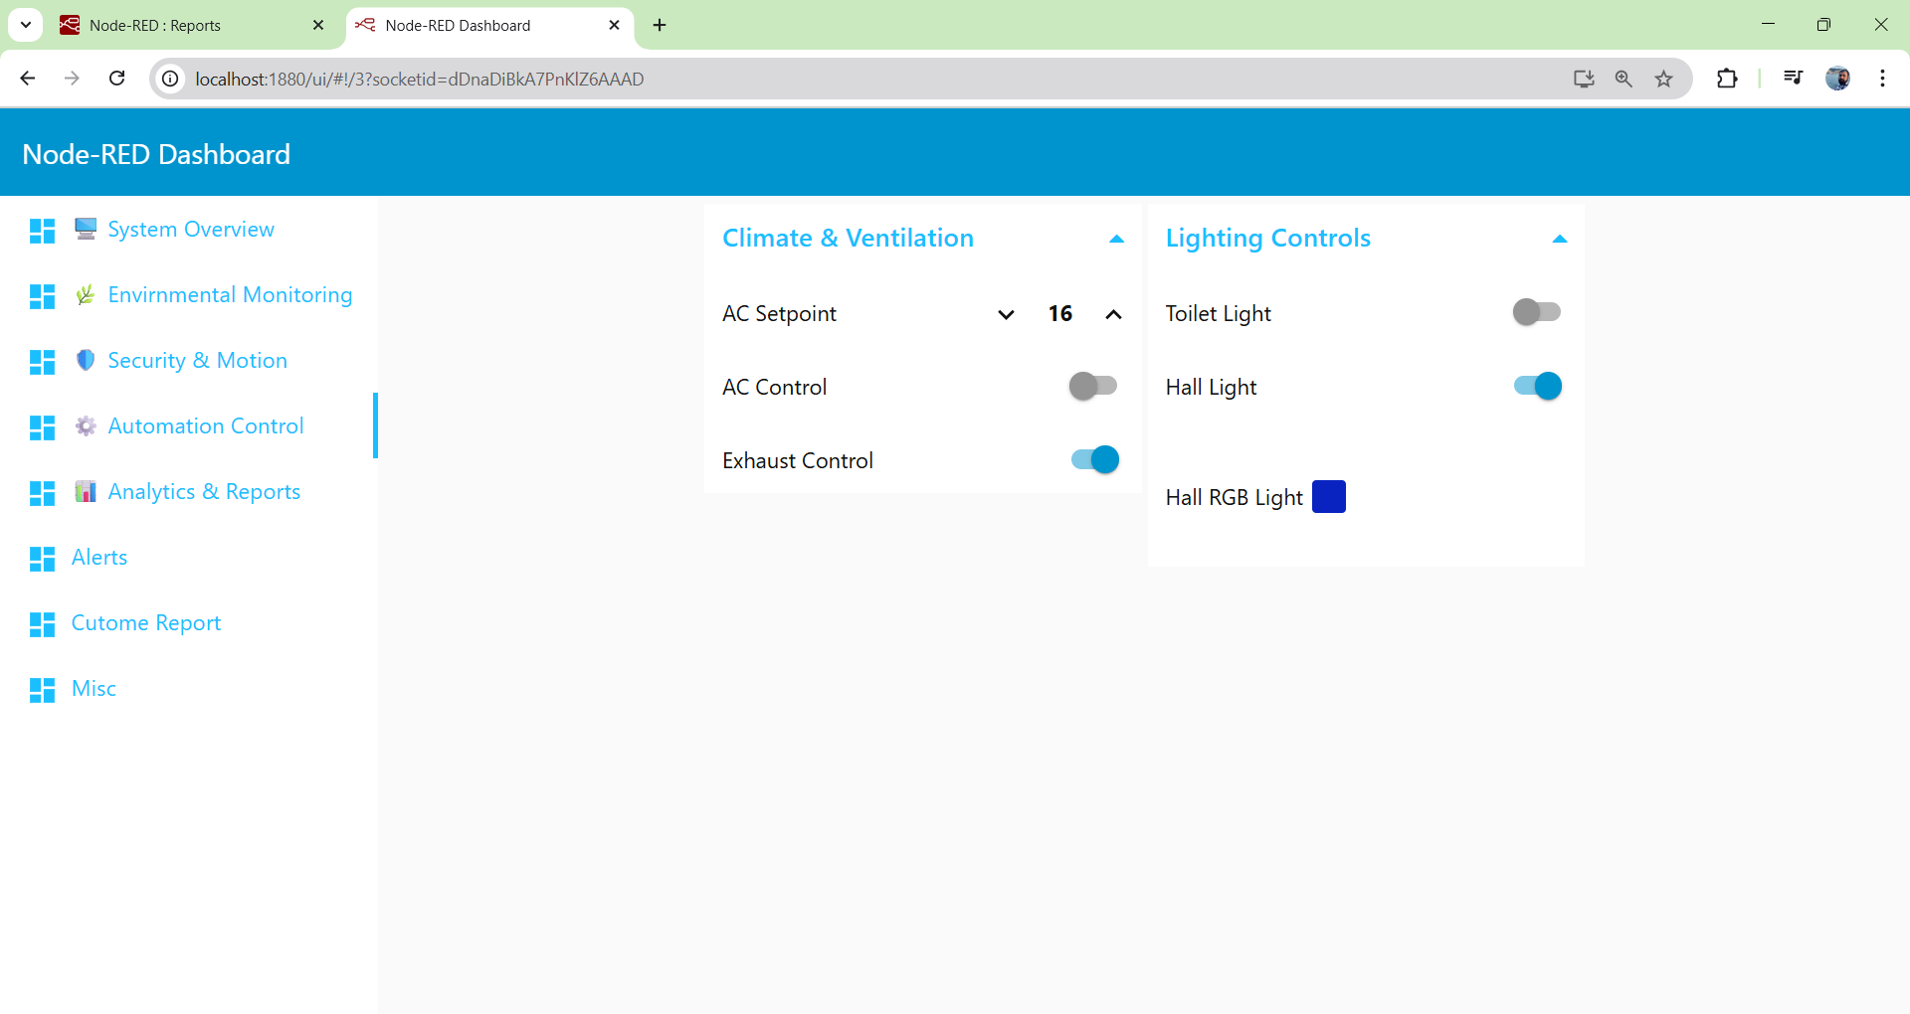
Automation Control

Slide 11
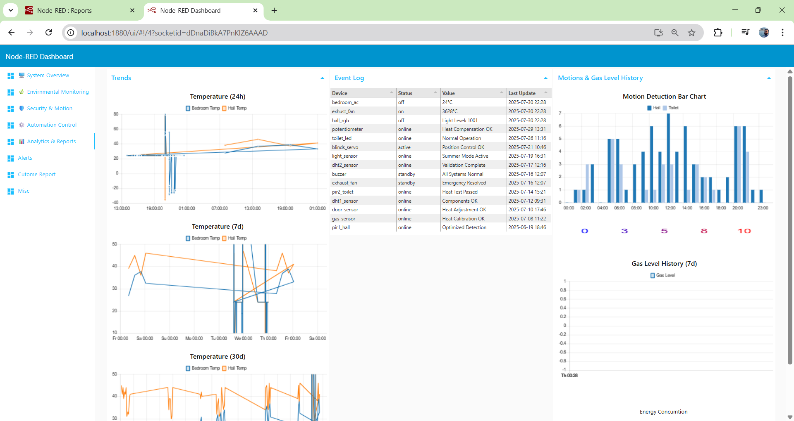
Analytics & reports

Slide 12




Technical Breakthroughs
A key challenge overcome was resolving frequent MQTT disconnections, crucial for stable data flow to Node-RED.
Problem Identified
Root Cause Analysis
MQTT disconnections every ~25 seconds (ERR: 128), leading to inconsistent data streams.
Identified as `keep-alive` timeout and insufficient JSON payload buffer sizes.
[30798][D][WiFiClient.cpp:536] connected(): Disconnected
Implemented Solutions
Successful Outcome
Reduced `keep-alive` interval to 60s.
100% connection stability achieved, ensuring consistent data flow and reliable system operation.
Increased buffer size for JSON payloads.
Implemented a 3-second retry logic for re-connection.
Enabled clean session management for MQTT client.

Slide 13
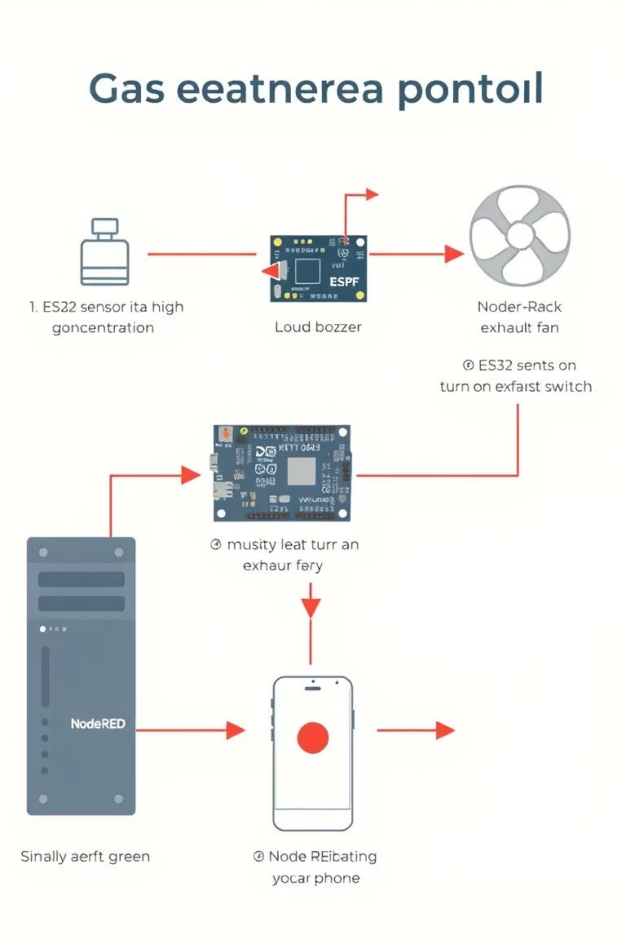

Safety Systems: Gas Emergency Protocol
The system incorporates robust safety features, particularly for gas leak detection, ensuring rapid response and user notification.
Fail-safes Implemented:
Automatic hardware cutoffs for critical appliances.
Graceful degradation of non-essential services during alerts.
Multi-channel alerts (buzzer, dashboard, potential push notifications).

Slide 14
Performance Metrics & Validation
Rigorous testing validated the system's accuracy, stability, and responsiveness, confirming its readiness for deployment.
Sensor Accuracy
98.5%
>95%
MQTT Latency
180ms
<500ms
Memory Usage (Flash/RAM)
27.1%/14.1%
<80%
Uptime
72h+
24h
Build Status
✅ Success
Operational
Stress tests simulating 15 devices confirmed no failures, highlighting the system's robustness and low resource utilization.

Slide 15

Node Red flows

Slide 16
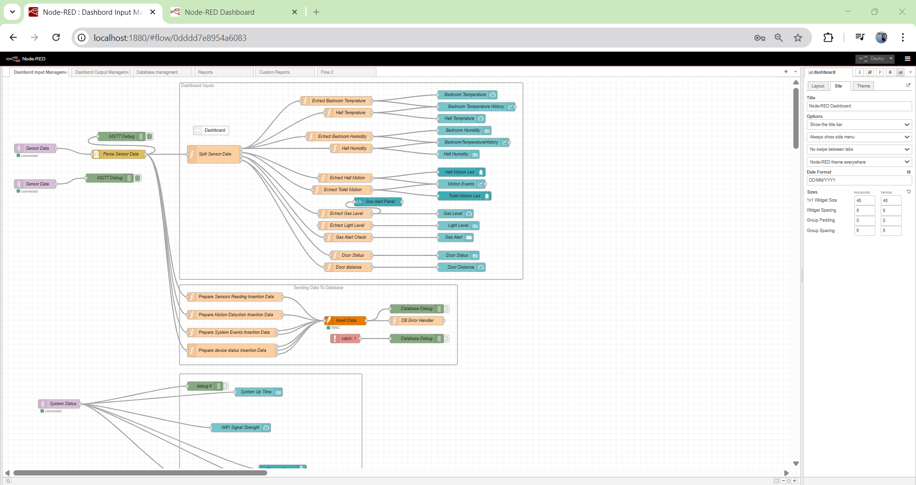

Slide 17
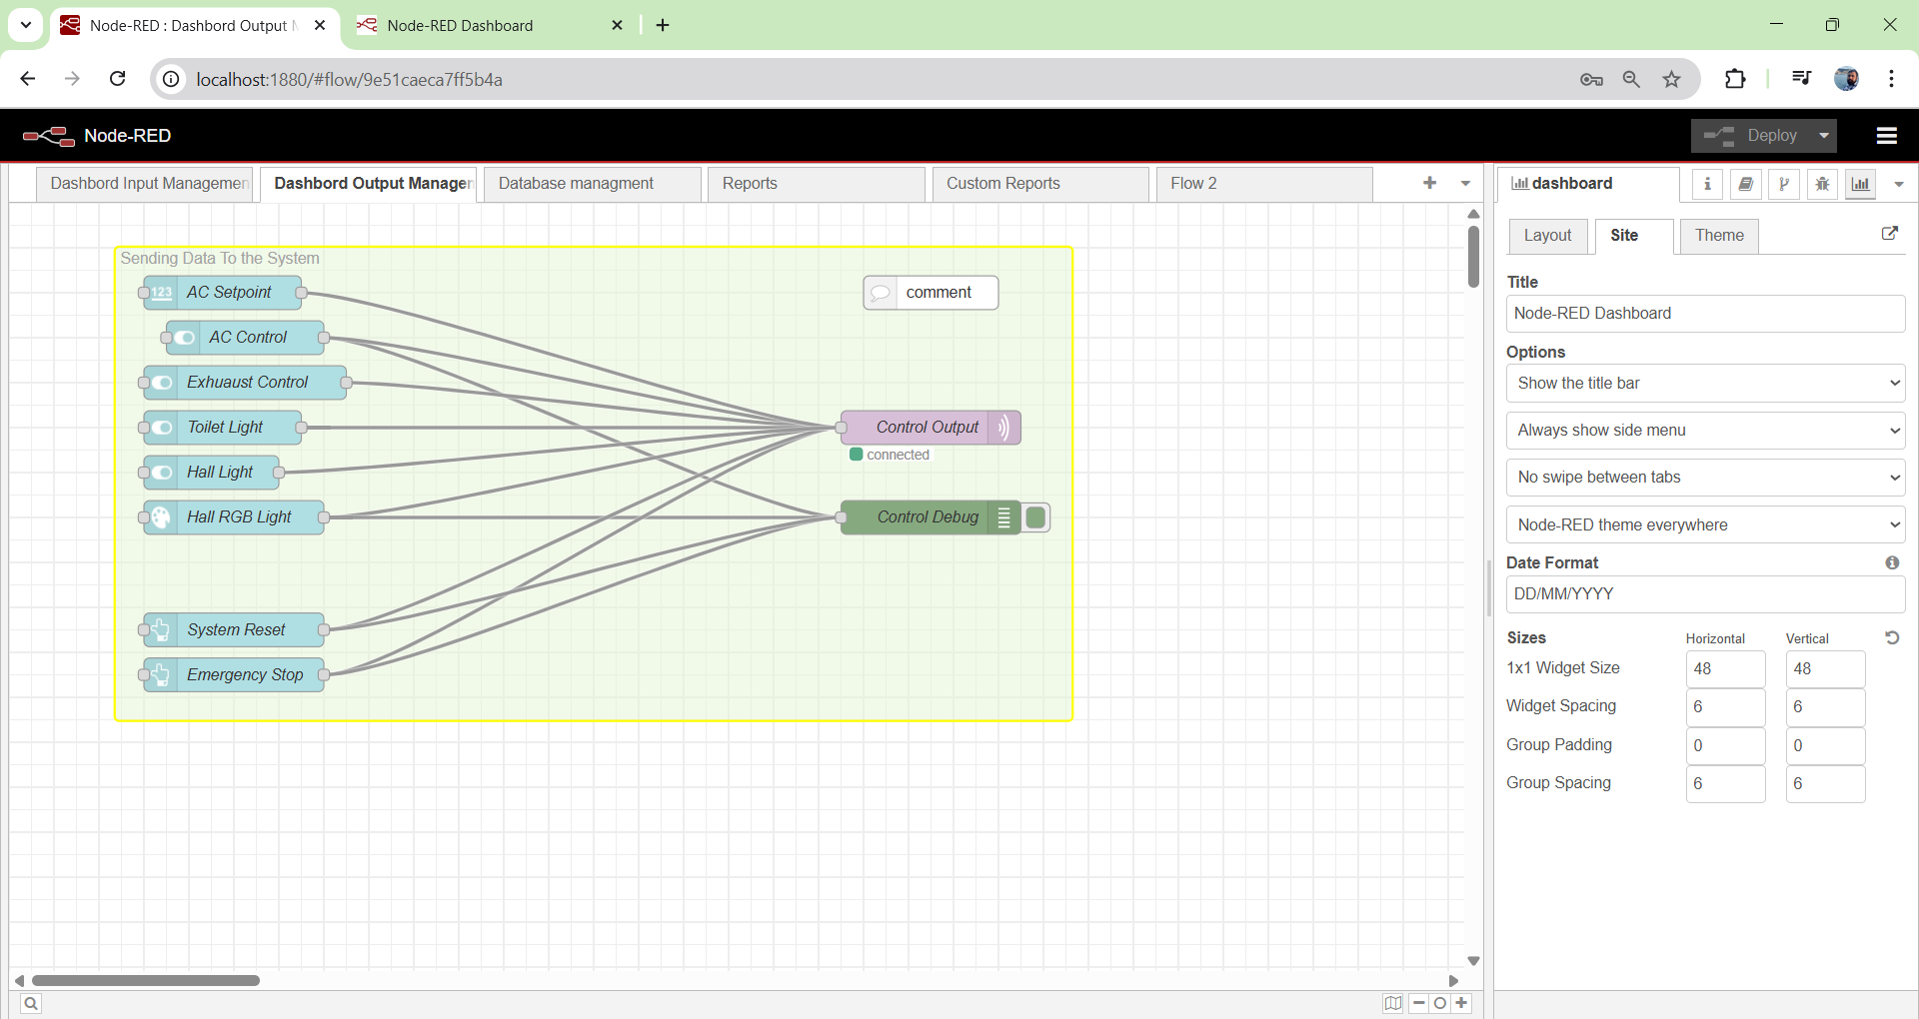

Slide 18
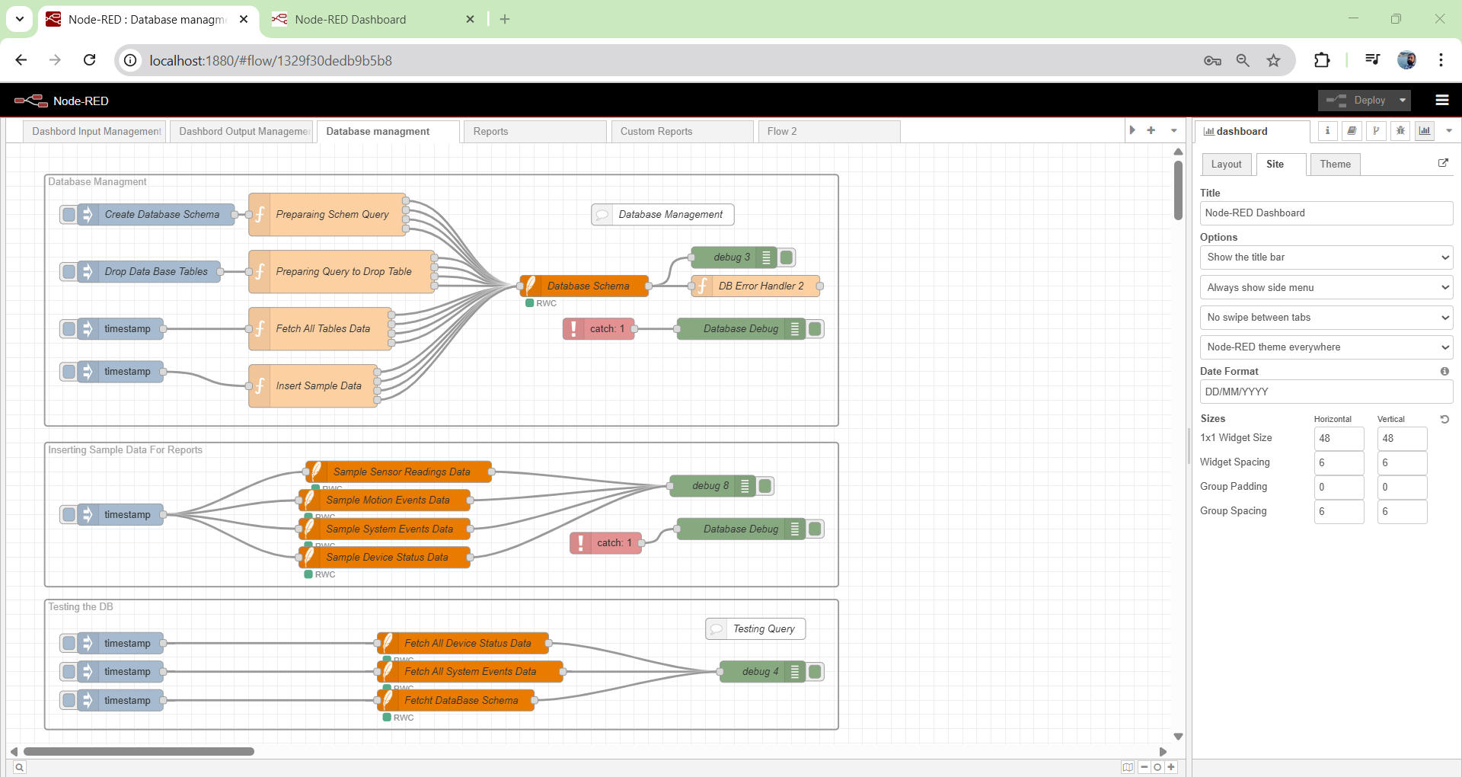

Slide 19
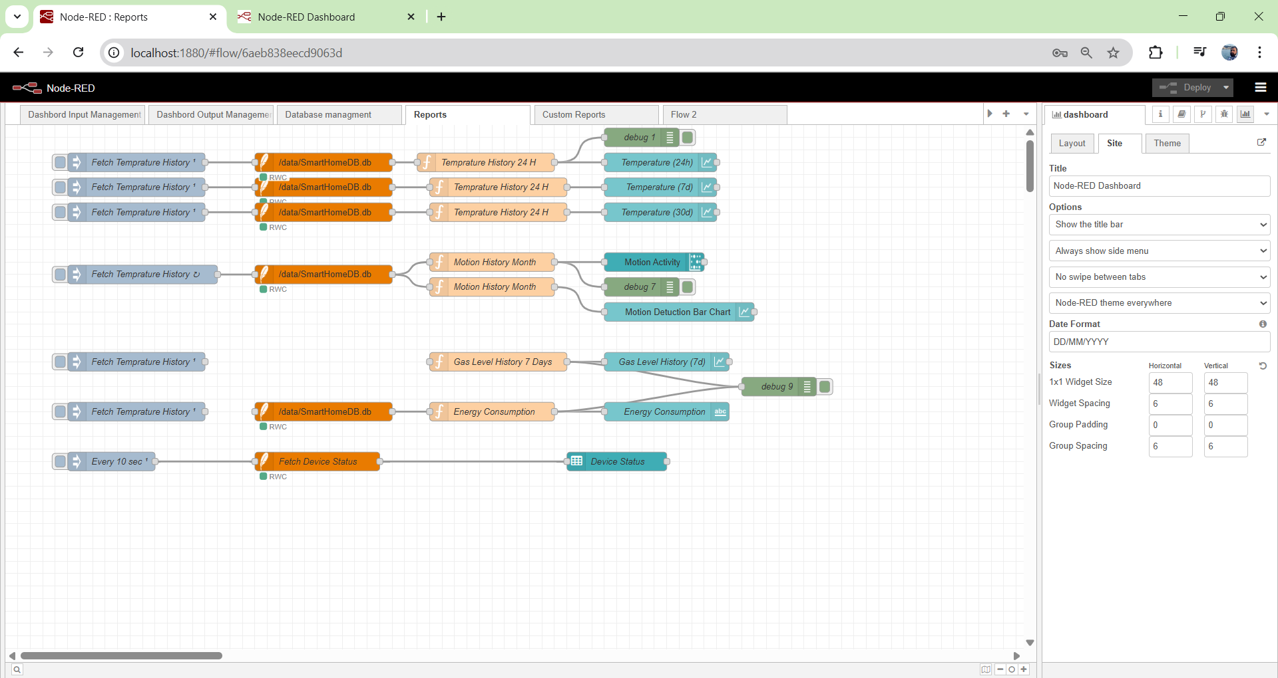

Slide 20
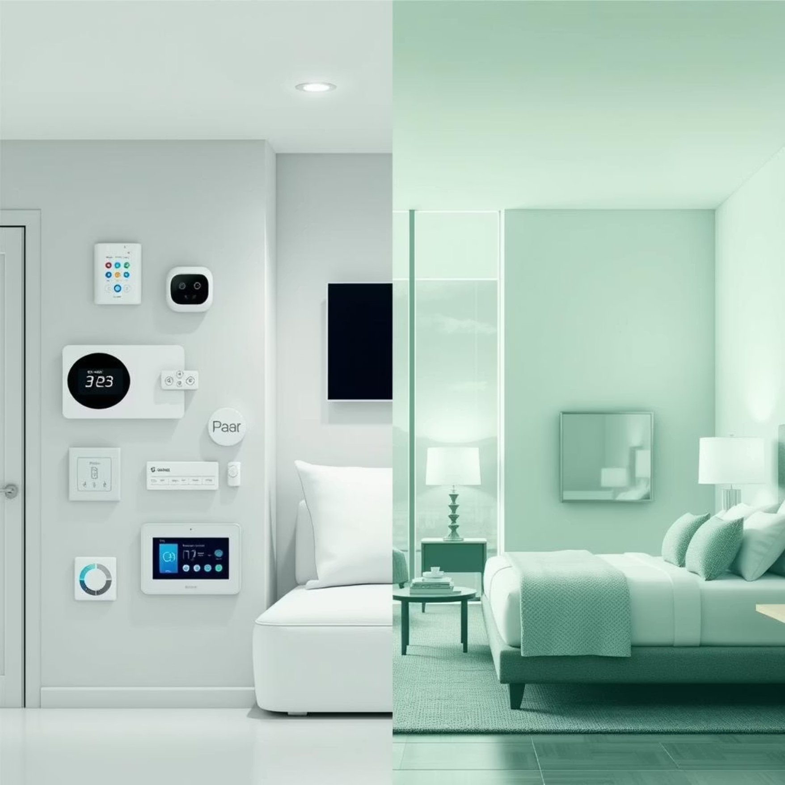
Real-World Applications
The smart home simulation project extends beyond a mere demonstration, offering tangible benefits across various sectors.
Home Automation & Safety
Energy Savings: Adaptive climate control and smart lighting optimize consumption.
Enhanced Security: Real-time door and motion monitoring provide peace of mind.
Accessibility: Foundation for future voice-controlled or mobile-app enabled systems.
Critical Safety: Immediate response to environmental hazards like gas leaks.
Beyond the Home:
The modular design and robust communication protocols make this system adaptable for hotel room automation, office energy management, and even elderly care systems, showcasing its versatility.

Slide 21
Challenges Overcome & Lessons Learned 💡
Our journey involved navigating complex technical hurdles and refining our project approach, leading to significant insights.
Technical Challenges
Project Management Insights
Network Stability: Resolved through redundant connection strategies and error recovery.
Iterative Development: Agile methodology proved essential for hardware-software integration.
Memory Management: Optimized through efficient data structures and buffer management.
Testing Strategy: Comprehensive testing at each integration phase prevented major issues.
Real-time Constraints: Achieved through careful timing analysis and interrupt handling.
Documentation: Detailed documentation facilitated troubleshooting and future enhancements.
Sensor Calibration: Improved accuracy through mathematical filtering and calibration.
Version Control: Systematic code management enabled collaborative development.

Slide 22
Future Roadmap & Enhancements
Our vision for the Smart Home Simulation project includes expanding its capabilities and further enhancing its intelligence.
Enhanced Intelligence
Commercial Viability
Leveraging machine learning, voice control, and advanced analytics to automate and optimize the system.
Improving security, interoperability, and simplified installation for wider adoption.
1
2
3
Ecosystem Expansion
Developing mobile apps, cloud platform integration, and energy management features.

